Slide 1
Information Visualization Visualization Sketch
G08-A
70969 – Mário Reis
75456 – Artur Fonseca
76046 – André Pires

Slide 2
Visual encoding
01

Slide 3
Visual Encoding
Course Unemployment %
Encoded as position in vertical axis
University Unemployment %
Encoded as circle area
Year
Encoded as position in horizontal axis

Slide 4
Visual Encoding
Course/University Name
Encoded as colours “hue” and position
Entry Grade
Encoded as position in horizontal axis
Course Area
Encoded as colour intensity
Area Unemployment [total]
Encoded as area in “Sunburst”

Slide 5
IDIOM – tasks/questions mapping
02

Slide 6
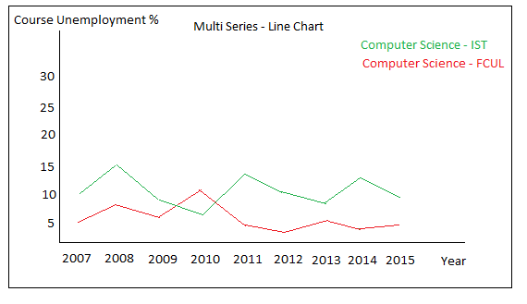
Task 1
Compare the unemployment (%) of different courses (regardless of course conclusion year of the graduates) - Query->Compare
Question: Does Computer Science graduates in IST have more unemployment, in 2015, than Computer Science in FCUL? And in 2007?
Due to interaction we can add more courses to the line chart and compare them.

Slide 7
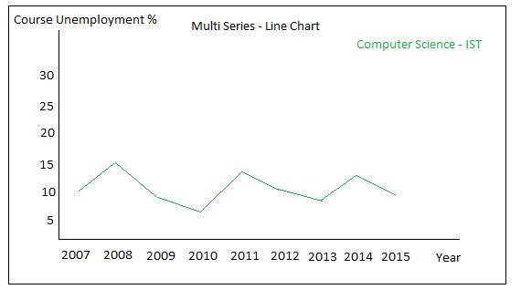
Task 2
Present the information about unemployment (%) from a specific course graduates across time - Analyse->Consume->Present
Question: Is Computer Science in IST having less unemployed graduates in last year’s? Is Computer Science in IST having less unemployed graduates in last year’s?
Question: What was the year which had less unemployed people from Computer Science in IST?
Line chart presenting unemployment of one course

Slide 8
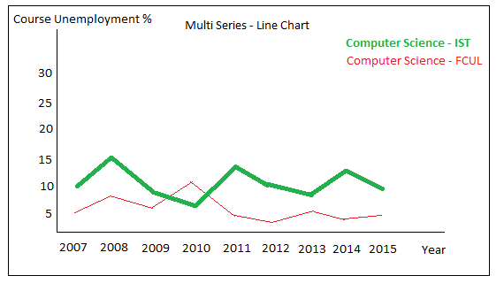
Task 1 & 2
It’s possible to select a course line and highlight the course in the other views.
Ex: Highlight the course dot in the next presented idiom

Slide 9
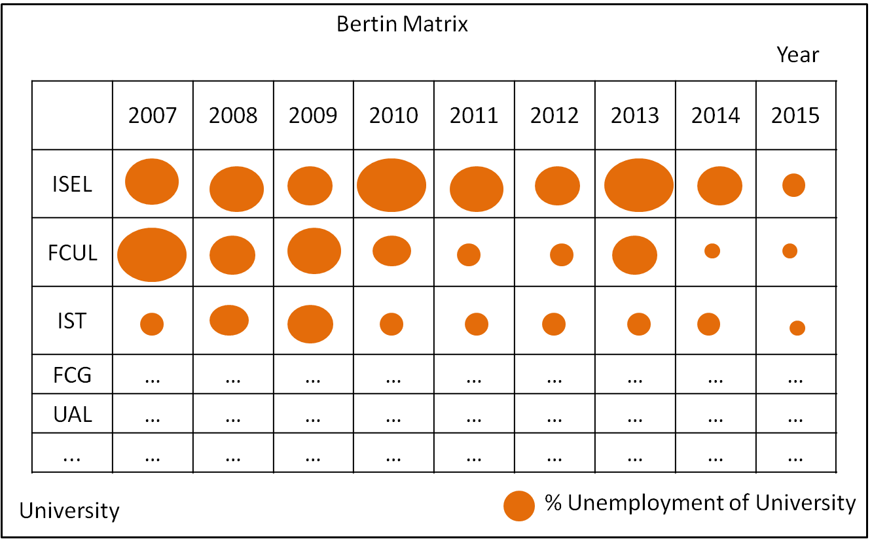
Task 3
Identify the university with more unemployment (%) - Query->Identify
Question: What is the university with more unemployment?
Sort the universities in ascending and descending order to give user both perspectives of the data
It will be possible to choose a particular university to see in the top of the matrix using interactivity, and the selection of a course will put that course university in the top and highlighted.

Slide 10
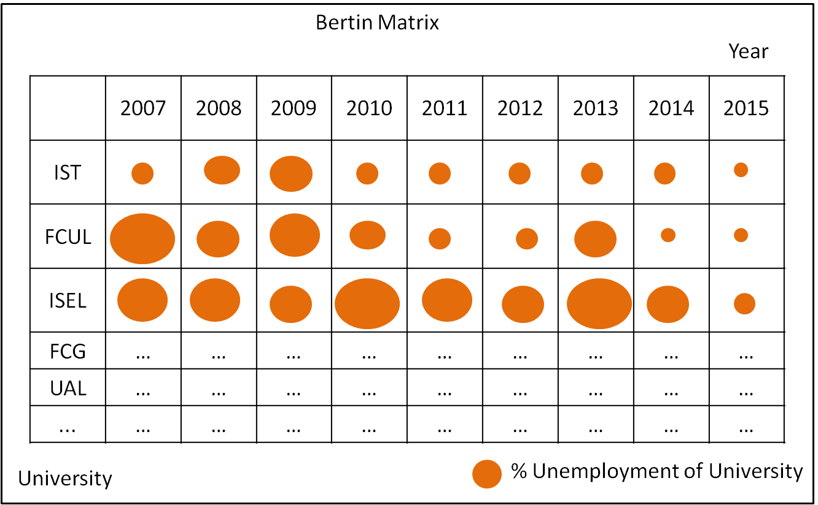
Task 3
We don’t have in our tasks nothing related to the university unemployment trends but we this approach we can see that in the matrix.
Note: The matrix will not contain all the universities because they are more than 200, the bottom universities in matrix will have smaller lines and will fade. But it will be possible to scroll, reorder and select a particular one as stated above. It will possible to have “tooltips” to each circle and see more details about the data that originated that one ex: Total unemployed and total graduates.

Slide 11
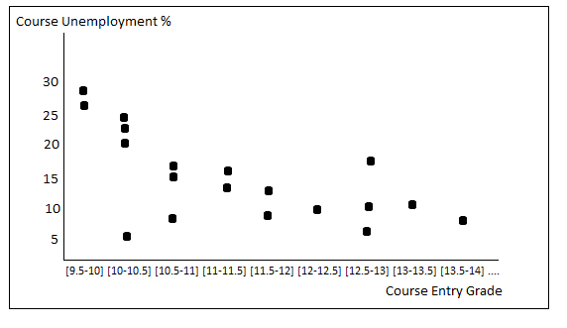
Task 4
Relation between minimum entry grade and unemployment (%) - Consume->Present
Question: Where the unemployment will be higher? In a course with 14 minimum entry grade or one with 17?

Slide 12
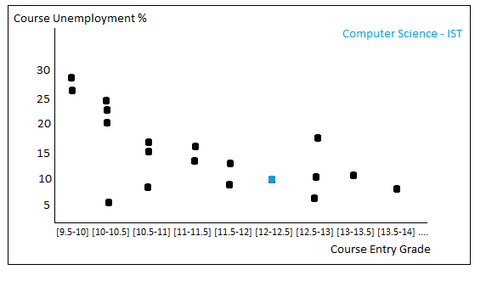
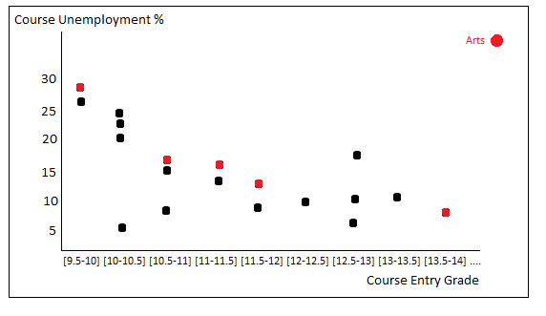
Task 4
Scatter plot highlighting a specific course (due to interaction) selected in course’s line chart
Scatter plot highlighting the course from a specific area due to interaction in area’s idiom

Slide 13
Task 5
Summarize the employment/unemployment by graduation areas - Query->Summarize
Question: What is the graduation area with less/more unemployment?
Unemployment by graduation area. Sunburst areas are based on total number of unemployed people. On “mouse over”, it will display the name and the unemployment %. On “click”, it will zoom that region

